Slide 1
Data Glacier G2M Case Study
Tarık Tuna Taşaltı
Week 2

Slide 2
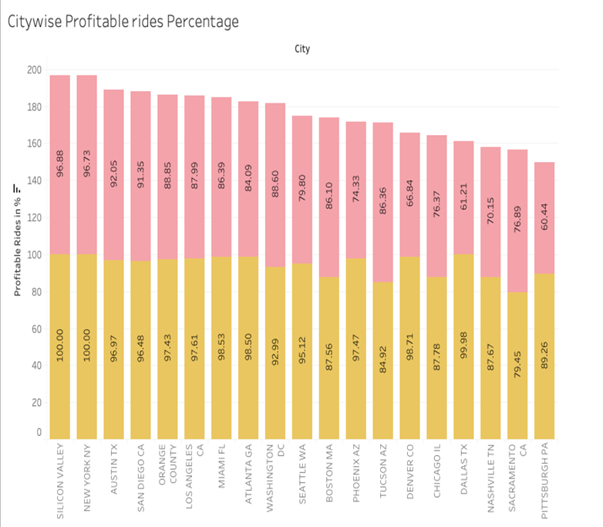
CITY CHOICE
In the attached table, it can be easily seen that cabs are more profitable in big cities.

Slide 3
GENDER
In attached table, it can easily seen that there is almost equal distribution of gender in the Profit and customer base of both the cabs.
Hence, safe travel advertisements for women can be made by using the pink taxi.

Slide 4
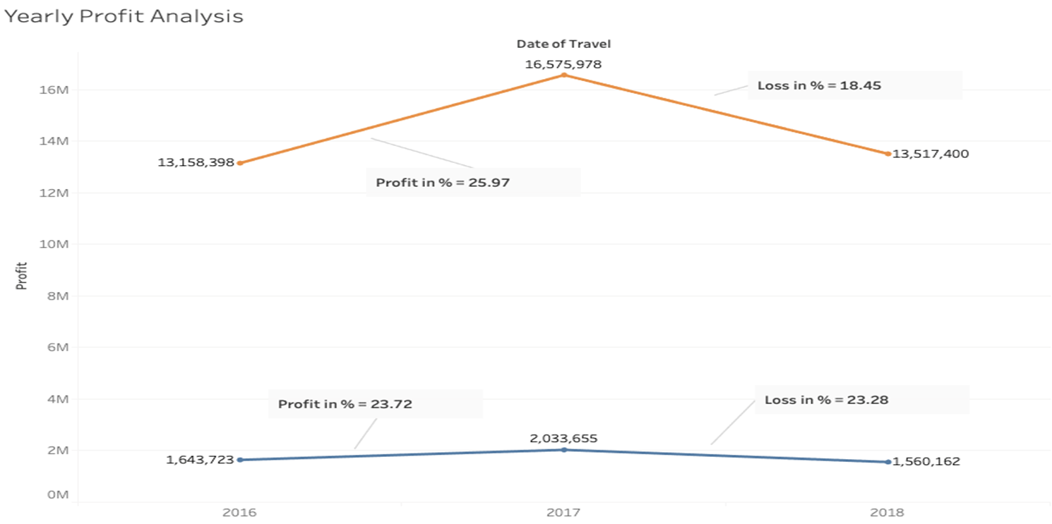
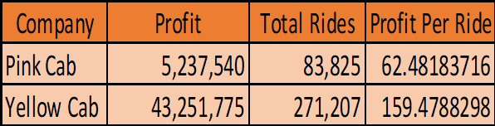
YEARLY PROFIT ANALYSIS
Between the two options, the yellow taxi has the larger market. On the other hand, the pink taxi has a more stable profit picture. The pink taxi seems to be a safer choice.

Slide 5
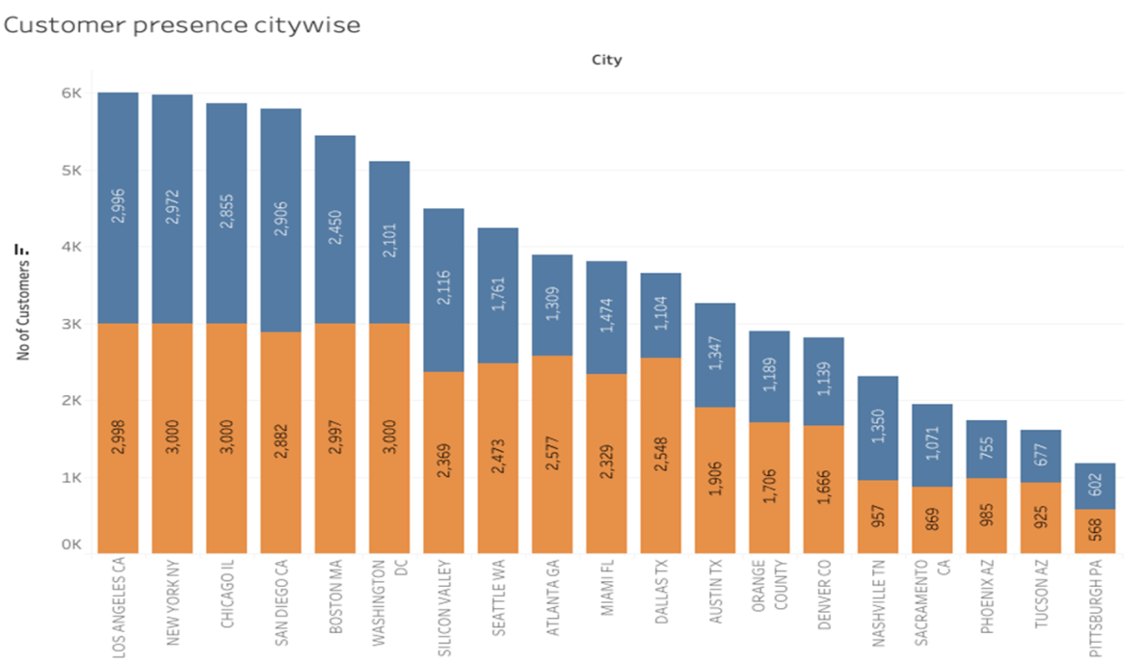
BEST CITY OPTION FOR PINK CAB
Out of 19 Cities Pink cab have higher customer reach as compared to Yellow cab ,in following 4 cities: SanDiego, Nashville ,Sacramento, Pittsburgh.

Slide 6
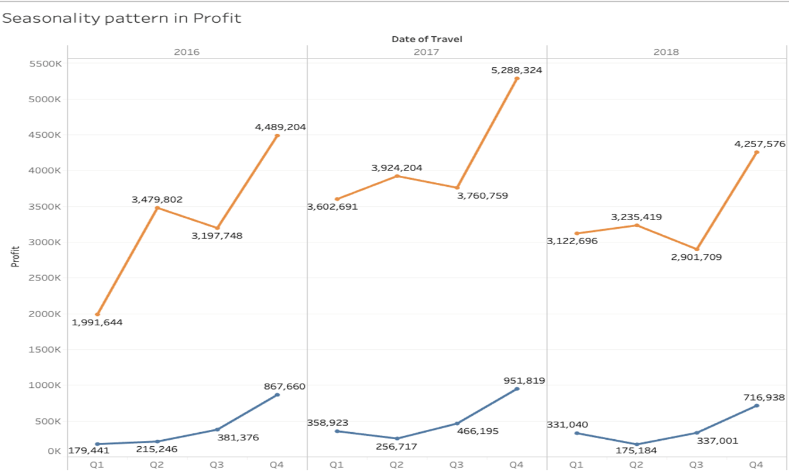
Seasonality in the Profit
Q4 is the most profitable quarter in a year.
Starting cab ad campaigns in late Q3 seems to be the right choice.

